Slide 1
Introduction to DevOps

Slide 2
Contents
DevOps
Advantages and Disadvantages
DevOps Architecture and Components
DevOps Lifecycle
DevOps Tools

Slide 3
DevOps
DevOps stands for Development and Operations.
DevOps is not a tool or a team, it is the process or a methodology of using various tools to solve the problems between Developers and Operations team.
DevOps helps you to reduce the disconnection between software developers, quality assurance (QA) engineers, and system administrators.
DevOps use for Implementing automation on each and every stage

Slide 4
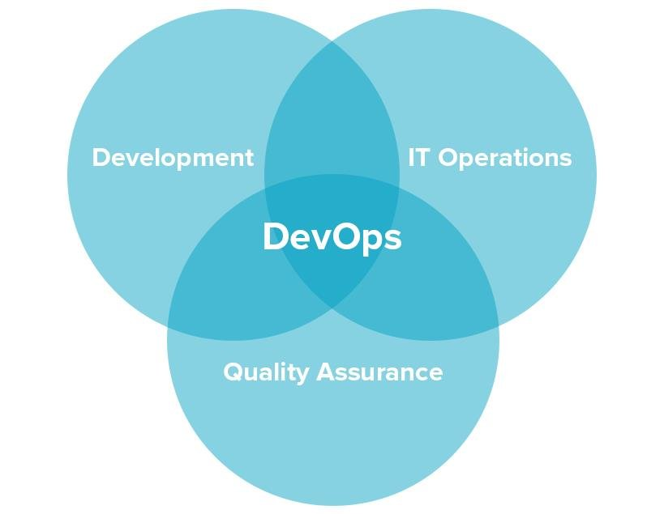
DevOps (Cont.)
It’s a practice that aims at merging development, quality assurance, and operations (deployment and integration) into a single, continuous set of processes.

Slide 5
DevOps Advantages
Higher speed and quality of product releases.
DevOps speeds up product release by introducing continuous delivery, encouraging faster feedback, and allowing developers to fix bugs in the system in the early stages. Practicing DevOps, the team can focus on the quality of the product and automate a number of processes.
Faster responsiveness to customer needs.
With DevOps, a team can react to change requests from customers faster, adding new and updating existing features. As a result, the time-to-market and value-delivery rates increase.
Better working environment.
DevOps principles and practices lead to better communication between team members, and increased productivity and agility. Teams that practice DevOps are considered to be more productive and cross-skilled.

Slide 6
DevOps Disadvantages
DevOps professional or expert's developers are less available.
Developing with DevOps is so expensive.
Adopting new DevOps technology into the industries is hard to manage in short time.
Lack of DevOps knowledge can be a problem in the continuous integration of automation projects.

Slide 7
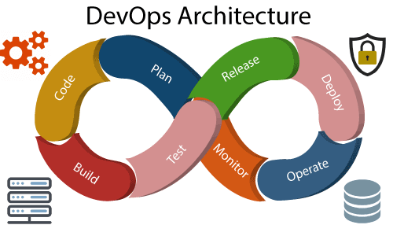
DevOps Architecture
Architecture

Slide 8
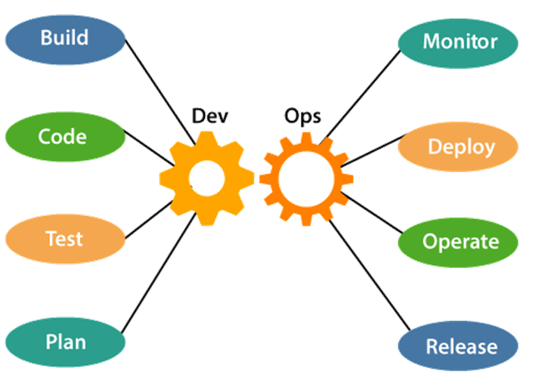
DevOps Components
There are the various components are continues process.

Slide 9
DevOps Component (cont.)
Plan
DevOps use Agile methodology to plan the development. With the operations and development team in sync, it helps in organizing the work to plan accordingly to increase productivity.
Code
The code can be appropriately arranged in files, folders, etc. And they can be reused. Many good practices such as Git enables the code to be used, which ensures writing the code for business.

Slide 10
DevOps Component (cont.)
Build
In DevOps, the usage of cloud, sharing of resources comes into the picture, and the build is dependent upon the user's need, which is a mechanism to control the usage of resources or capacity. Means to execution.
Test
A quality assurance team sets committed code testing using automation tools like Selenium, Junit etc. If bugs and vulnerabilities are revealed, they are sent back to the engineering team. The application will be ready for production after testing.

Slide 11
DevOps Component (cont.)
Monitor
Continuous monitoring is used to identify any risk of failure. Also, it helps in tracking the system accurately so that the health of the application can be checked. The monitoring becomes more comfortable with services where the log data may get monitored through many third-party tools such as Splunk, Nagian.
Deploy
Many systems can support the scheduler for automated deployment. The cloud management platform enables users to capture accurate insights and view the optimization scenario, analytics on trends by the deployment of dashboards.

Slide 12
DevOps Component (cont.)
Operate
The teams operate in a collaborative way where both the teams actively participate throughout the service lifecycle. The operation team interacts with developers, and they come up with a monitoring plan which serves the IT and business requirements.
Release
Deployment to an environment can be done by automation. But when the deployment is made to the production environment. Means to integrate

Slide 13
DevOps Lifecycle
Continuous Development
This phase involves the planning and coding of the software. The vision of the project is decided during the planning phase. And the developers begin developing the code for the application. There are no DevOps tools that are required for planning, but there are several tools for maintaining the code.

Slide 14
DevOps Lifecycle (Cont.)
Continuous Integration
This phase involves the build and coding of the software. The code supporting new functionality is continuously integrated with the existing code. The updated code needs to be integrated continuously and smoothly with the systems to reflect changes to the end-users.
Whenever there is a change in the Git repository, then Jenkins fetches the updated code and prepares a build of that code, which is an executable file in the form of war or jar. Then this build is forwarded to the test server or the production server.
Jenkins is a popular tool used to automate this phase.

Slide 15
DevOps Lifecycle (Cont.)
Continuous Testing
This phase, where the developed software is continuously testing for bugs. For constant testing, automation testing tools such as TestNG, JUnit, Selenium, etc are used. These tools allow QAs to test multiple code-bases thoroughly in parallel to ensure that there is no flaw in the functionality.

Slide 16
DevOps Lifecycle (Cont.)
Continuous Monitoring
Monitoring is a phase that involves all the operational factors of the entire DevOps process, where important information about the use of the software is recorded and carefully processed to find out trends and identify problem areas. Usually, the monitoring is integrated within the operational capabilities of the software application.
The system errors such as server not reachable, low memory, etc are resolved in this phase. It maintains the security and availability of the service.

Slide 17
DevOps Lifecycle (Cont.)
Continuous Feedback
The application development is consistently improved by analyzing the results from the operations of the software. This is carried out by placing the critical phase of constant feedback between the operations and the development of the next version of the current software application.

Slide 18
DevOps Lifecycle (Cont.)
Continuous Deployment
In this phase, the code is deployed to the production servers. Also, it is essential to ensure that the code is correctly used on all the servers.
Here are some popular tools which are used in this phase, such as Chef, Puppet, Ansible, and SaltStack.

Slide 19
DevOps Lifecycle (Cont.)
Continuous Operations
Its last phase where all DevOps operations are based on continuity with complete automation of the release process and allow the organization to accelerate the overall time to market continuingly.

Slide 20
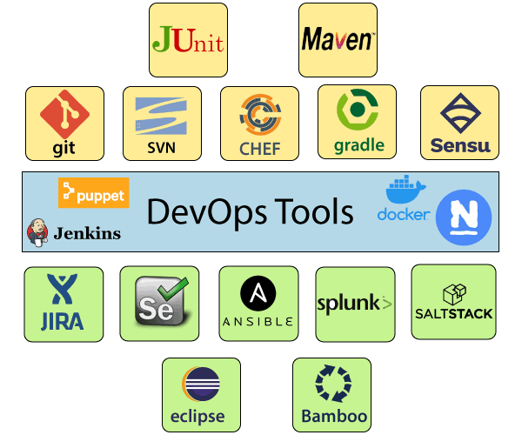
DevOps Tools
Some most popular DevOps tools

Slide 21
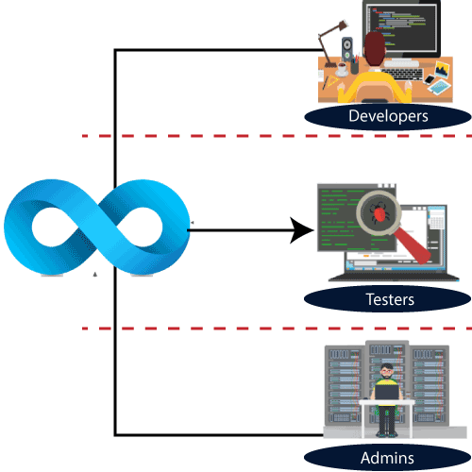
DevOps Engineers
DevOps Engineer is an IT professional who works with system operators, software developers, and other production IT staff to administer code releases.

Slide 22
DevOps Engineer Roles and Responsibilities
DevOps engineers work full time.
DevOps engineer understands the software development lifecycle and various automation tools for developing digital pipelines.
They are responsible for the production and continuing maintenance of a software application platform.
Manage projects effectively through an open standard based platform.
Improve quality and reduce the development cost with collaboration.
DevOps should have the soft skill of problem solver and a quick learner.
Analyze, design, and evaluate automation scripts and systems.
Able to perform system troubleshooting and problem-solving across the platform and application domains.
Ensuring the critical resolution of system issues by using the best cloud security solution services.

Slide 23
Thanks
…?

